Slide 1
Foundations of inference
Week 2

Slide 2
Part 1: parametric statistical models

Slide 3
Trinity of statistical inference
This refers to 3 main questions that we may ask, once we get the data
Estimation. Single numerical estimate of parameter of interest. Estimator is random variable based on data. We treat it as r.v. because we want to assess its performance
Confidence intervals: Basically, an error bar for the estimate
Hypothesis testing. Looking whether we have statistical evidence or not (Yes, no questions)
The goal of statistics is to learn the distribution of X (r.v.) (usually from a lot of observations of X)
Example: estimating the distribution of N of sibling that students have at MIT
We can do this analytically, but also with modeling, say with Poisson’s distribution and in this case, only 1 parameter is needed instead of many (reduces unknowns needed)
The more parameters we need to learn, the more data we need

Slide 4
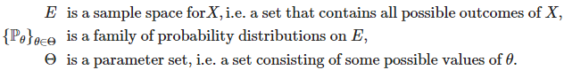
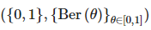
Statistical model
The model is slightly simpler than the reality, but trying to capture the most of it
Formal definition of a statistical model: let the observed outcome of a statistical experiment be a sample X1,…,Xn of n i.i.d random variables in some measurable space E and denote by P their common distribution
Then a statistical model associated to that statistical experiment is pair
Where, E is sample space, P is family of probability measures on E (e.g. P Poisson distributions with all possible positive parameters
Example:

Slide 5
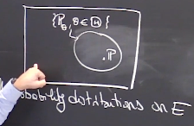
Parametric, nonparametric and semiparametric models
Usually, we will assume that the statistical model is well specified, defined such that true distribution is inside of family of distributions we choose
Then we aim to find the true parameter of that distribution,
Which is unknown
The aim of the statistical experiment is to find that parameter or check its properties (e.g. is theta>2)
We often assume that vector of values, but specified dimension- the it is parametric
Sometimes we could have theta to be infinite dimensional in which case the model is called nonparametric
We have also hybrid models, called semiparametric
Example of non-parametric model (X1,…,Xn are i.i.d with unknown unimodal pdf f, so we just given pdf as info)

Slide 6
Insight from exercises
When specifying statistical models, it is best to describe the sample and parameter space as detailed as possible, however, if it is not detailed enough (wider) but includes the correct range of values, then this is also correct
Parametric vs non-parametric models
A statistical model is parametric if all parameters can be specified by a finite number of unknowns, equivalently, this means that is a subset of .
In particular, if , then P is uniquely specified by the m entries of the vector
Identifiability is a property of a parameter of a statistical model.
Injectivity is a property of a function. Whether or not a function is injective is a question you could ask of any function at all.
A parameter is identifiable if the related function from the parameter to a probability distributions is injective.

Slide 7
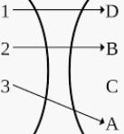
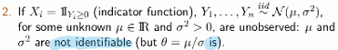
Identifiability
Injectivity-an injective function (also known as injection, or one-to-one function) is a function that maps distinct elements of its domain to distinct elements of its codomain. In other words, every element of the function's codomain is the image of at most one element of its domain.
Here we explore the question of whether the model is identifiable or not
The parameter is called identifiable if the map is injective, that is
Every unique theta (parameter vector) defines different distribution
So, here our aim is to have such a parameter of model, so that given its distribution we can recover the parameter of distribution

Slide 8
Part 2: parametric estimation and confidence intervals

Slide 9
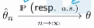
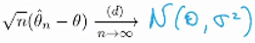
Statistics, Estimators, Consistency, and Asymptotic Normality
Estimation (parameter estimation) is probably the most natural thing you might want to do when you are faced with a statistical inference question
You observe the data, if your model is well specified you know that it comes from one of the candidate probability distributions, then most natural questions is, can I find from which one (find parameter of distribution?
Some definitions in parameter estimation:
Statistic: Any measurable function of the sample (data) e.g. sample avg, sample max
Estimator of theta. Any statistic whose expression does not depend on theta (it is like a function of data, that is computable once we have the data)
Once, we choose (find) estimator we are interested in its properties (of course ideal estimator is the one that equals to true theta, but it’s impossible) and we want it to have some desirable properties 1) An estimator is consistent, that is
2) Estimator is asymptotically normal if
And quantity sigma^2 is then called asymptotic variance of
Statistic is function of data, estimator is a special statistics that doesn’t depend on theta

Slide 10
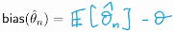
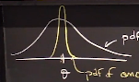
Bias and variance of Estimators; Jensen's Inequality
Once we found an estimator, we are interested in how close it is to true theta and how variable are estimates of it based on data
The 1st thing we are interested to know is the bias of an estimator: which is:
expected value of difference between estimator and true parameter
Ideally, we want the bias=0, that is, make it unbiased, in many cases, it was one 1st properties of estimators that needs to be checked, but we need to make sure not to overdo it (estimators that are unbiased, but have too much variability, overfitting)
2 extreme cases on the right (unbiased but highly variable, biased but low variab)
Jensen’s inequality: if function f() is convex then E[f(x)]>=f(E[X]), if f is concave then opposite
So, as we see bias alone is not enough to see whether estimator is good or bad (var may help)
In this case, we compare variance

Slide 11
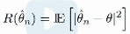
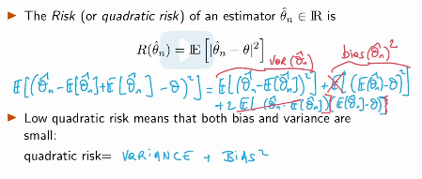

Bias and variance trade-off
This is also a multi-objective optimization problem
This is done by making trade-offs
Turns out that there is a natural way of combining bias and variance: quadratic risk
The risk (quadratic risk) of an estimator is
It equals to variance +bias^2, so we need to minimize the quadratic risk function for choosing optimal estimator
Var( ) + ( )^2

Slide 12
Miscellaneous
Biased estimators inherently introduce errors in parameter estimation. Hence, having non-zero bias is a potential disadvantage of an estimator
If the estimator does not converge to the true parameter as the sample size n grows very large, this is also a potential disadvantage. Estimators that are not consistent have inherently limited accuracy in approximating the true parameter, regardless of how many samples are taken.
convergence in L^2 to denote convergence in mean-square was not introduced in 6.431x. However, the theorem is that convergence in mean-square implies convergence in probability .

Slide 13
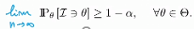
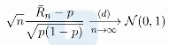
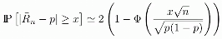
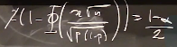
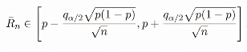
Confidence intervals
Asymptotic normality princip will help us to build error bars around the estim.
Let be a statistical model based on observations X1,…, Xn
Confidence interval (C.I.) of level 1- alpha for theta: any random (depending on X1,…,Xn) interval I whose boundaries do not depend on theta and such that
which means probability of an interval containing theta
CI of asymptotic level (or asymptotic CI) for theta: any random interval I whose boundaries do not depend on theta and such that

Slide 14
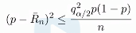
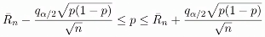
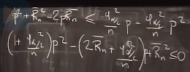
Confidence intervals continued
So using CLT we transformed probability to a problem of estimating probability of normal r.v from its CDF
But to do it we still need a variance of a r.v. of interest say Xi
So, there are 3 solutions:
Use conservative bound – wider p(1-p) – ½
Solving the equation for p
-Rn from both sides and square
so the p will be between 2 roots (in this interval)
3) Replace p by p_hat

Slide 15
Links on convergence
https://www.statisticshowto.com/convergence-of-random-variables/
https://www.statlect.com/asymptotic-theory/convergence-in-distribution
https://www.statlect.com/asymptotic-theory/convergence-in-probability
https://www.statlect.com/asymptotic-theory/pointwise-convergence

Slide 16
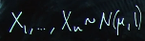

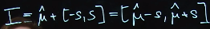
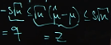
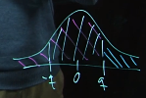
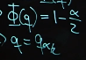
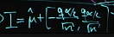
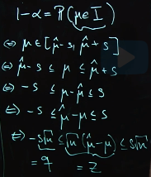
Recitation 1
2-sided confidence interval for my is mu_hat+/-s
or P( abs(mu^-mu)<=s)=1-alpha
P(my is interval my^+/- s)=1-alpha
My^-s<mu<mu^+s; -s<mu-mu^<s; -s<mu^-mu<s;
So we have probability that z is in [-q;q] which is phi(q)-phi(-q) or
2*phi(q)-1

Slide 17
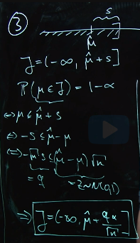
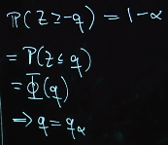
So, confidence interval is just an interval (mu^+/s) with some center
Ideally, we want that center to be mu itself
We, want the outside of interval probability be equal to alpha
One-sided Confidence interval

Slide 18





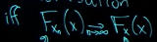
Recitation: Modes of convergence
Convergence almost surely - Xn sequence of random variables will converge to X almost surely when P(Xn -> X)=1 or lim as n-> inf Xn=X
Convergence in probability
Convergence in distribution means conf of CDFs

Slide 19
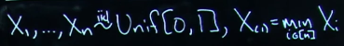
Almost sure convergence and conv in probability
Here we need to show that P(Xn -> X) =1
We are given that Xn=U+U^n; U uniform-[0,1], so we say Xn -> U
P(X -> U)=P(X -> U/U<1)*P(U<1) + P(X ->U/U=1)*P(U=1)
P(U=1)=0, P(U<1)=1 and when U<1, P(X -> U)=1; P(X ->U/U=1)=0, because when U=1 Xn ->2 not U
So, we use law of total probability
In conv in prob we need to show that
We are given X1,…Xn i.i.d Unif [0,1] and Xn=minXi, we want to show Xn ->0
So P( abs(Xn)>eps)=0

Slide 20
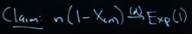
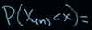

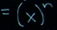
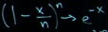
Convergence in distribution
We are given X1,…Xn are i.i.d Unif [0,1] Xn=max Xi
We want to check the claim n(1-Xn) -> (distr) exp(1)
1st we find the CDF of Xn= x^n
Then we find the CDF of given random variable and rearrange it so that it becomes the CDF of Xn P(Xn>(1-x/n))=1-P(Xn<(1-x/n))=1- (1-x/n)^n
For n->inf we have , so 1- (1-x/n)^n = 1-exp(-x), which is CDF of exp(1)

Slide 21
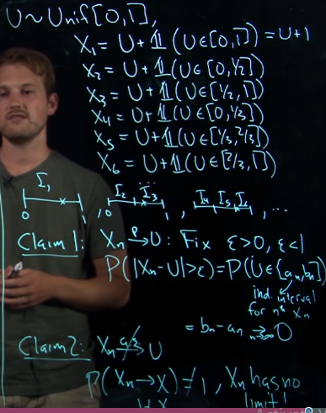
Convergence in probability vs almost sure
As n -> inf Xn=U
P(abs(Xn-U)>eps)= P of U falling in certain inter
Which is decreasing as n grows
So probability approaches 0, meaning conv in prob
We also claim that Xn does not converge to U
Almost surely because values of Xn alternate
Between U and U+1, although taking more often
Value of U rather than U+1
So, Xn do not have well defined limit as n -> inf

Slide 22
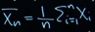
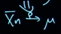
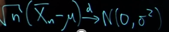
Final examples of conv a.s; in prob; in distribution
Law of large numbers (LLN) has 2 forms: strong and weak
We are given X1,…,Xn i.i.d with E[Xi]=my
Strong LLN says , whereas weak LLN says
Whereas, CLT is about convergence in distribution, it just requires an additional assumption that var(Xi)=sigma^2 some finite value
Then distribution of properly scaled sample mean converges to normal distribution

Slide 23
Lecture 5. Delta method and confidence intervals

Slide 24
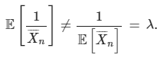
Confidence intervals
Wider than necessary CI also true, as they contain true interval
Confidence intervals of some asymptotic level need not be symmetric around the estimate, the just need to include the specified probability say 50% [0,0.5]
P(p is in some deterministic interval is either 0 or 1), so saying that p is in this deterministic interval with 95% probability is wrong
By Jensen’s inequality

Slide 25
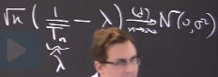
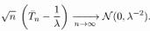
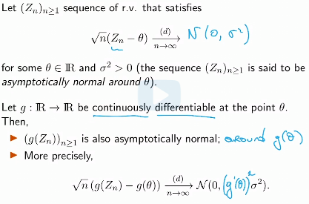
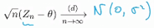
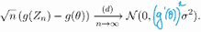
Delta method for confidence interval
By the LLN’s Tn (avg of exp r.v.) -> 1/lyamda and hence,
Lyamda^ converges to lyamda
By CLT,
But we want another expression of form where 1/Tn-lyamda -> N(0,lyamda^2)
So we want to apply function to inside brackets g(x), in this case 1/x (like in continuous mapping theorem)
G(x) should be differentiable at all inputs x

Slide 26
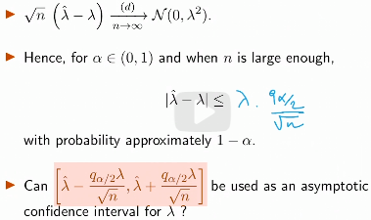
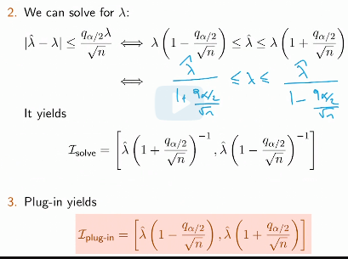
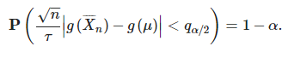
Conditions for applicability of delta method
g’(x) should exist and be continuous near x
Now that we got a confidence interval for
Lyamda in the following form, we can’t use it
Since CI depends on lyamda
So, now we need a way to replace lyamda
We can’t use a cons bound, since lyamda is
Unbounded
2) We can solve for lyamda and then plug in
3) We can use value of lyamda^ in place of lyamda

Slide 27
Frequentist interpretation of confidence interval
Frequentist means that you can repeat the experiment and we are interested in what happens as we repeat this experiment over and over until an infinite amount of time
If we were to repeat this experiment, then true parameter would be in the resulting confidence interval about 1-alpha % of the time
Overall, the procedure for constructing confidence intervals is as following
1) determine for which parameter you want to construct a CI, say for example it is mean of some distribution
2) come up with a consistent estimator for that parameter of interest
3) come up with expression that is proper scaled version of that estimator (random variable), so that its distribution is of standard normal
4) Construct a confidence interval of the form P(abs(X-my)<eps)=1-alpha

Slide 28
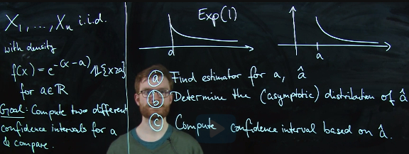
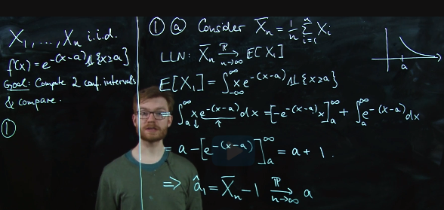
Recitation 3
a

Slide 29
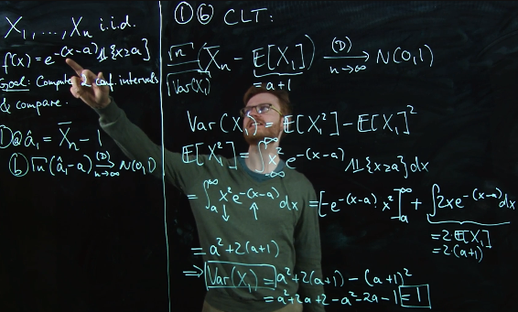
Rec 3 continued
a
P(a2>t)=e^-n(t-a); let’s set t*=1/n*t+a then -n(1/n*t+a-a)=-t, so P(a2>1/n*t+a)=e^-t
That is (a2-a)*n has distrib of exp(-1)

Slide 30


Slide 31

Recitation continued; minimum as estimator
a

Slide 32

One-sided confidence interval
a

Slide 33

a
a

Slide 34





Assumptions of WLL, CLT and delta method
Asymptotic variance of an estimator for a parameter is defined as If:
The arguments that we use to establish normality are often
Same in our setups, LLN, CLT and the Delta Method
WLL if X1,X2.. are i.i.d. with finite mean, then sample mean -> expected value
Whereas, CLT states that
Assumptions of CLT are: mean and variance are finite and r.v. are i.i.d
Delta Method gives us a way to control the asymptotic variance of a transformation of a random variable or apply function to estimator so that it converges to the value we want it to converge
Assumptions of Delta method: function g is continuously
Differentiable near point theta; variance W>0 and and this formula comes from Taylor series

Slide 35

a
a

Slide 36
Hypothesis testing
Learning objectives:
Reformulate experimental questions in terms of a hypothesis test by specifying an appropriate null hypothesis and an alternative hypothesis .
Design statistical tests to decide between a null and alternative hypothesis.
Identify a hypothesis test as a one-sample or two-sample test .
Compute the type 1 error and type 2 error associated to a statistical test.
Describe the difference between parametric hypothesis testing and parameter estimation .

Slide 37
Introduction to hypothesis testing
By using hypothesis testing we seek to answer various questions (e.g. is some parameter>some value?)
In hypothesis testing setting we have 2 competing hypotheses and we ask question which of them is the suitable one
We answer this question by collecting data, selecting model and taking some assumptions
So, in hypothesis testing problem, we formulate 2 hypotheses, and after applying some methods we try to select the accurate hypothesis and extrapolate this scientific inquiry among the entire population of flights

Slide 38
Model and assumptions
Let X and Y denote the boarding time of JetBlue and United flights (so we model observations as r.v.)
Then, we need to assume a model for r.v. (here we take )
Let n and m denote the JetBlue and United sample sizes respectively
We have X1,…,Xn independent copies of X and Y1,…,Yn independent copies of Y
Further, we assume that the 2 samples are independent
So, overall we assume that Xi and Yj are i.i.d and independent from each other for all I’s and j’s
We want to answer the question is
By making modeling assumptions, we have reduced the number of ways the hypothesis may be rejected. We do not allow that
We have 2 samples. So this is a 2 sample test

Slide 39


Modeling assumptions
Good scientific inquiry should start with modeling assumptions then proceed to data collection
In previous problem, we further restrict out assumption by not allowing
You should not look at data and then make your assumptions, assumptions need to be made based on understanding of physical process
In 2 sample tests, one if often used as reference and the other one is used as the thing you are actually trying to test
Now, we explore question of whether we can conclude that Xi>Yi by just comparing the means of sample distributions (Heuristics for 2 sample test)
Answer is no, because we have variance, sample size to take into account that allow us to find the amount of fluctuation in those values
Instead, we can compare them after doing this
Using just means to make a decision is just heuristics
For 1-sample test, we compare to some actual number. Heuristic here

Slide 40
One-sided test vs two-sided test
A one-sample test is a hypothesis test where an unknown parameter s to be compared to a known reference value. For example, the U.S. heights example was a one-sample test because we wanted to compare the unknown mean from 2018 to the known average height from 1920, which was 5.5
A two-sample test is a hypothesis test where two unknown parameters are compared to each other. For example, the clinical trial example is a two-sample test because we want to compare the unknown my_drug to the unknown my_control to quantify the drug effect.

Slide 41
Hypothesis testing principle
Say we have some hypothesis (Ber(p)) that p=0.33 and we have collected data and have sample mean
Given the data we can construct a distribution for parameter of interest
Then, hypothesis testing principle is about evaluating how possible is to get the given data, given that our hypothesis is true
Or we can use true p and construct a normal distribution and then given estimate based on data compute the z-score and see where in distribution our data point is
So, the idea is to map the given problem into Gaussian percentiles with given percentage of error tolerance and then backpropagate the error in % to the scale given in the problem

Slide 42


Statistical formulation for hypothesis testing
We consider a sample X1,…,Xn of i.i.d. random variables and a statistical model
Let
We consider 2 hypotheses H0 and H1, which are disjoint
H0 is the null hypothesis, H1 is the alternative hypothesis
If we believe that the true theta is either in theta0 or theta1, we may want to test H0 against H1
We want to decide whether to reject H0 (look for evidence against H0 in the data)
It is innocent until proven guilty, that is lack of evidence, does not mean that H0 is true
Regardless of the data, our conclusion will never be to accept the null. On observing the data, we will either reject the null in favor of the alternative OR we will fail to reject the null. In the latter case, we are not claiming that the null is true, rather we are stating that the data does not provide us with enough evidence to refute the null hypothesis

Slide 43


Statistical tests
Test statistics is a function, that takes data and turns it into the number 0 or 1
In coin example, H0: p=0.5 vs H1 p=/0.5
How do we choose the threshold C?
A (statistical) test is a statistic whose output is always either 0 or 1 and like an estimator, does not depend explicitly on the value of true unknown parameter.

Slide 44


Type 1 error of a statistical test
So when choosing a value for C, this decision should not be arbitrary
We need to optimize this for something, specifically we want to optimize for the errors, so that we get the least error possible
Rejection region of a test : this means rejection region is defined as a region when observations (X1,…,Xn) live in particular parameter space, then our indicator function is as following
There are 2 type of errors that we can make while doing hypothesis testing
Type 1 error of a test (rejecting Ho when it is actually true)
Alpha is a function from theta0 to R that maps some theta into P
In other words alpha is a function of indicator function (like what conditions we have for indicator function for it to have a value of 1, and that alpha when given input of function gives the probability of error)-given H0 is true P(psi=1)

Slide 45


Type 2 error and power of a test
Type 2 error (b) is a probability of not rejecting H0, although H1 is actually true
Power of a test psi is defined as that is probability of rejecting H0, when actually H1 is true, which is good thing
In 1-b we look at its lowest value (the worst case)
To plot this graph we need 1) boundary value 2) power of the test, to plot value of function at boundary, then extrapolate to 1 as theta-infinity 3) To the left of the boundary we have type 1 error 4) To the RHS we have the opposite of type 2 error

Slide 46




Level of a statistical test
A test has level if (think alpha=1%, 5% etc)
That is we want to limit the prob of type 1 error to alpha , that if I have an innocent person, I want the probability that I send them to jail to be at most 5%
A test has asymptotic level alpha if
Type 1 error is probability of maxXi>C given that H0 is true
Alpha is like the worst case scenario type 1 error (under most extreme H0 values)

Slide 47

One-sided vs two-sided tests
One-sided is when say we have H0:theta=2; H1: either theta> or <2
Two-sided is when say we have H0: theta=2; H1 is theta not equal to 2
In 2-sided we have an absolute value in our test that is P(abs(theta)>1)

Slide 48
Introduction to Parametric Hypothesis Testing: Worked examples, P-values
Objectives
Specify the level or asymptotic level of a statistical test
Design a statistical test with a specific level or asymptotic level
Apply a test to a given sample to determine whether or not the null hypothesis should be rejected
Compute and interpret the p-value associated to a statistical test
Goal of hypothesis testing
To decide with a quantified probability of error whether or not theta (parameter of interest) lies in a certain region of the parameter set
The null and alternative hypotheses describe complementary subsets of the parameter set. Statistical test is a data dependent rule that decides whether or not to reject the statement (hypothesis) that the unknown true parameter theta belongs to the subset described by H0 or fail to reject it
In designing a statistical test, we must quantify how likely it is that the observed sample is generated by a probability distribution Ptheta for theta in H0

Slide 49

2-sided test associated to a Bernoulli experiment
We want to control the level of a test, that is the worst case of probability of type 1 error
We want to decide on value (q) when we will start to reject the H0 and limit the maximum of probability of this event (rejection) happening under H0

Slide 50
Definitions
1) Test statistics is an indicator function, that takes data and turns it into the number 0 or 1 (if null or alternative hypothesis is selected respectively)
Inside it, we have a condition for it to be either 0 or 1 and test statistics does not depend explicitly on the value of true unknown parameter.
To define a statistical test it is enough to define the rejection region (values of data for which we reject the null hypothesis)
Test is by definition an indicator function of its rejection region, to define a test, all that is needed is to define its rejection region.
2) Rejected region is a set of all X’s (data) that lead to rejection of null hypothesis
3) Type 1 error is a function from theta0 to R (Prob) is depend on criteria for rejection-
In other words, alpha is a function of indicator function (like what conditions we have for indicator function for it to have a value of 1, and that alpha when given input of function gives the probability of error)-given H0 is true P(psi=1)

Slide 51
Definitions
4) Power of a test psi is defined as ,that is probability (worst case-lowest, depending on value of observed parameter) of rejecting H0, when actually H1 is true, which is good thing
5) Level of a test is a value of the worst case alpha (type 1 error)
Under most extreme values of H0 and H1

Slide 52
Errors, Levels, and Conclusion of a One-Sided Test
So when picking p for the worst-case alpha (type 1 error rate), the p that we want is the one at boundary between H0 and H1
If values of H0 are in between the values for H1, then we should check both boundary values and see which one gives us higher alpha (type 1 error rate)

Slide 53
Introduction to p-values
P-value is what people produce in their papers when they say, I have made a discovery from my data or not
The reason for that is the fact that it is universal (does not depend on 1) what test we use 2) what asymptotic distribution we use) and it also on the same scale as alpha (type 1 error)
Rather than putting specific cut-offs like 1%, 5%, 10%, it places cut-off on the area under the curve scale (between 0 and 1)
P-value small-reject and it gives an actual number rather than 0 or 1 so that at a different alpha it is obvious whether we still reject or not
Definition: The (asymptotic) p-value of a test is the smallest (asymptotic) level alpha at which rejects H0, it is random, it depends on the sample
is rejected by test, at the asymptotic level alpha
The smaller the p-value, the more confidently one can reject H0

Slide 54

Recitation: Hypothesis testing
a

Slide 55

Recitation: Hypothesis testing
a

Slide 56

Recitation: Hypothesis testing
a

Slide 57

Composite Test
a

Slide 58
Calculation of type 2 error and power of a test
We specify 1st the type 1 error, which is given that H0 is true (substitute H0) rejecting it, say we specified it to be 0.05 or alpha
Then we find value of X_bar when we happen to enter this region, so we say when X_bar>1.96 say we reject null, so when X_bar<1.96 we do not reject
Then when H1 is correct we find the probability of X_bar<1.96 (we substitute for example 1.96 for value of X_bar) and then finds its z-score and probability
Power of a test is 1- type 2 error

Slide 59



A Two-Sample Test on Standardized Test Scores
A
A Union-Intersection Test

